Slide 1
Sales Performance Analysis of Walmart Stores Using Advanced MySQL Techniques
NIKHIL S KUMAR

Slide 2

Introduction
Objective
Analyse Walmart transactional data to derive insights on sales performance, customer behaviour, and product trends.
Business Problem
Walmart wants to optimize its sales strategies by analyzing historical transaction data across branches,
customer types, payment methods, and product lines. To achieve this, advanced MySQL queries will be
employed to answer challenging business questions related to sales performance, customer segmentation, and
product trends.

Slide 3
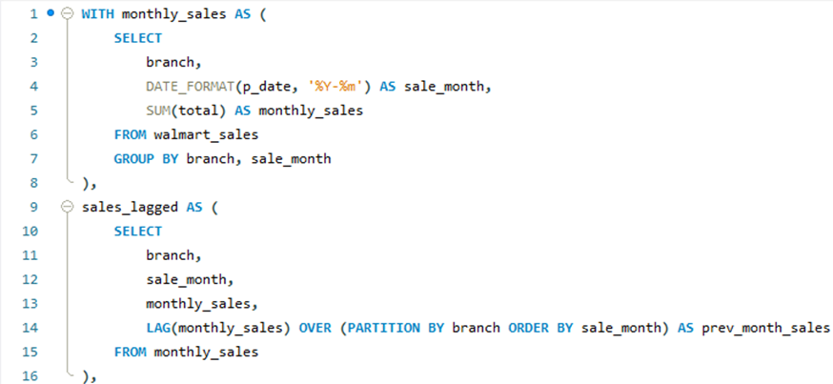
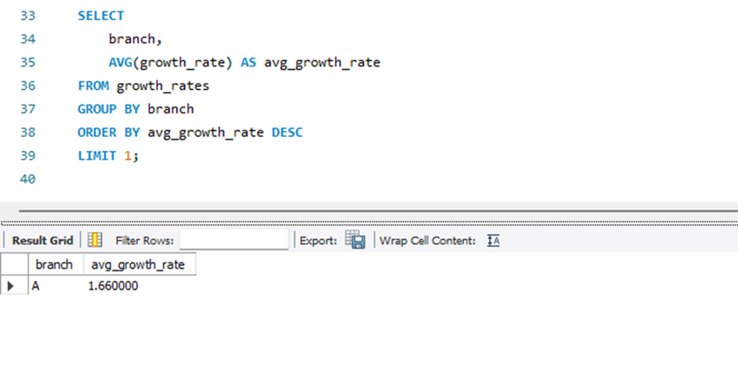
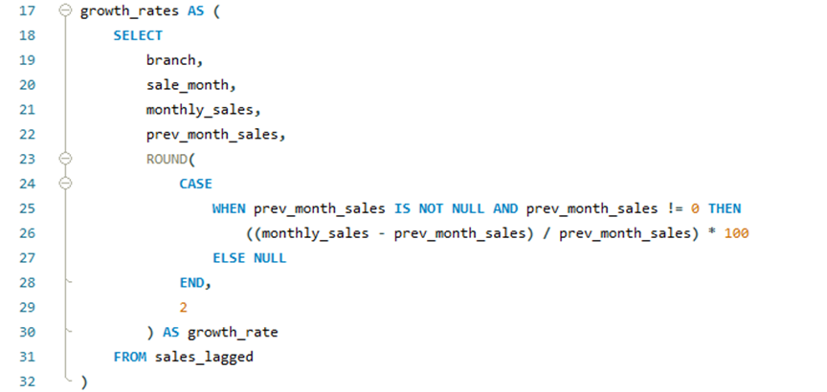
Task 1 : Identifying the Top Branch by Sales Growth Rate
Walmart wants to identify which branch has exhibited the highest sales growth over time. Analyse the total sales for each branch and compare the growth rate across months to find the top performer.

Slide 4
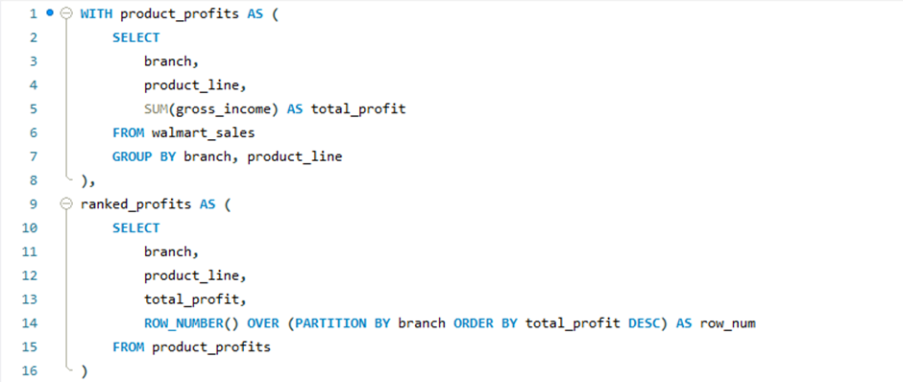
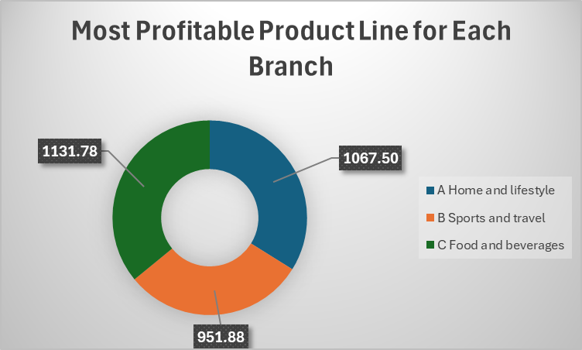
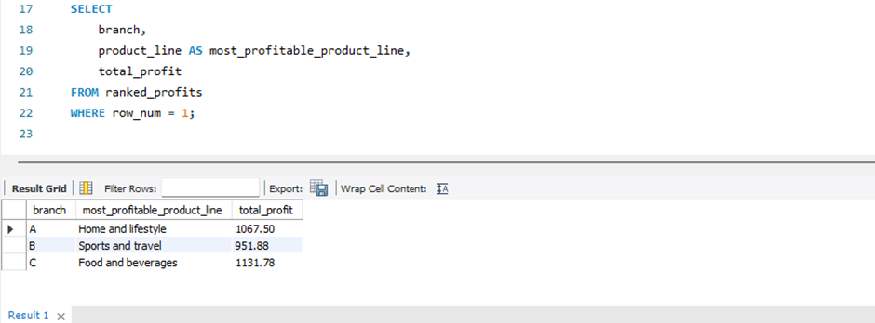
Task 2 : Finding the Most Profitable Product Line for Each Branch
Walmart needs to determine which product line contributes the highest profit to each branch. The profit margin should be calculated based on the difference between the gross income and cost of goods sold.

Slide 5
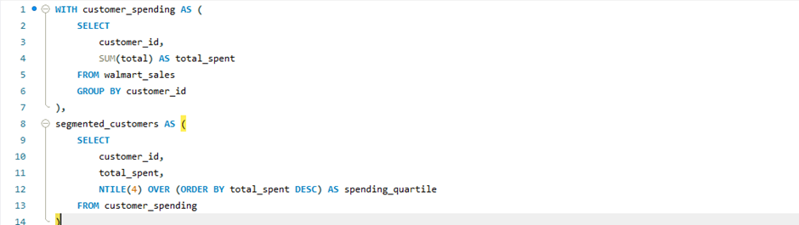
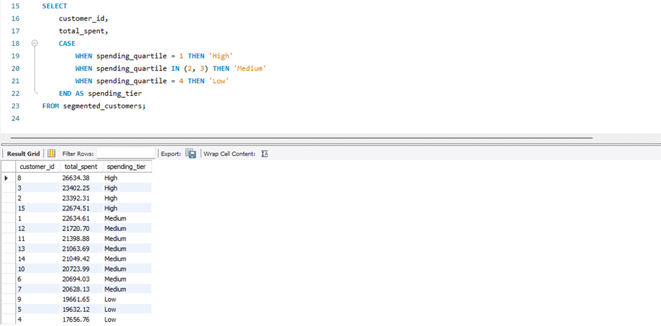
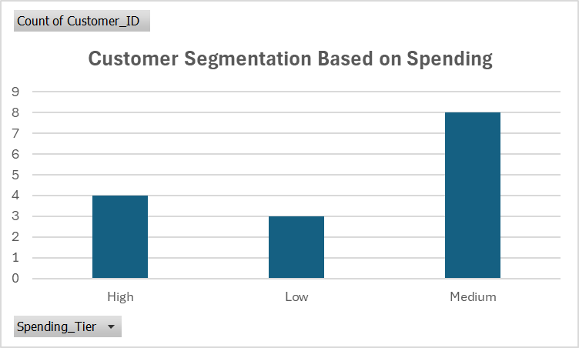
Task 3 : Analyzing Customer Segmentation Based on Spending
Walmart wants to segment customers based on their average spending behavior. Classify customers into three tiers: High, Medium, and Low spenders based on their total purchase amounts.

Slide 6
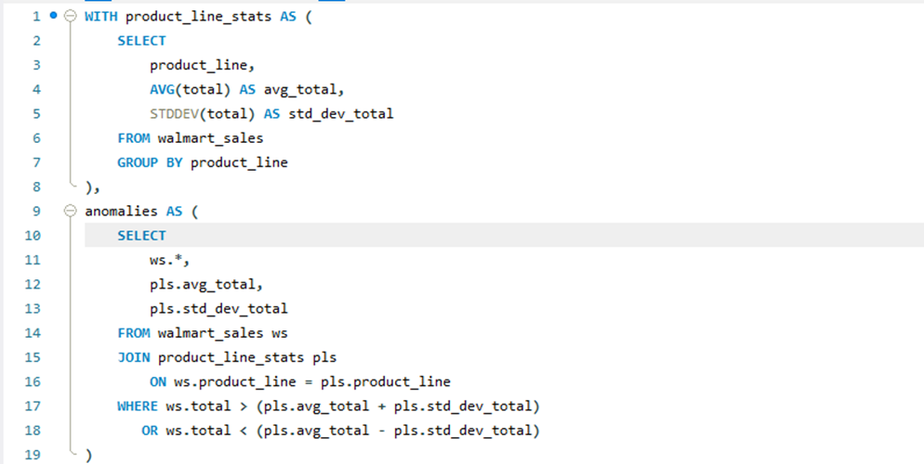
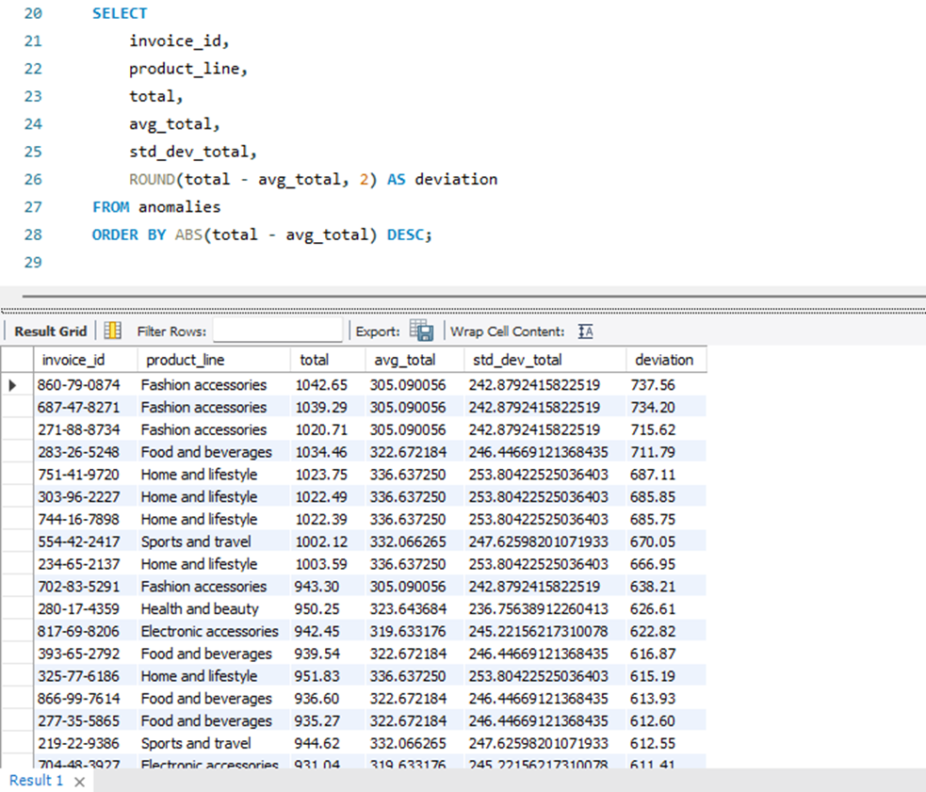
Task 4 : Detecting Anomalies in Sales Transactions
Walmart suspects that some transactions have unusually high or low sales compared to the average for the product line. Identify these anomalies.

Slide 7
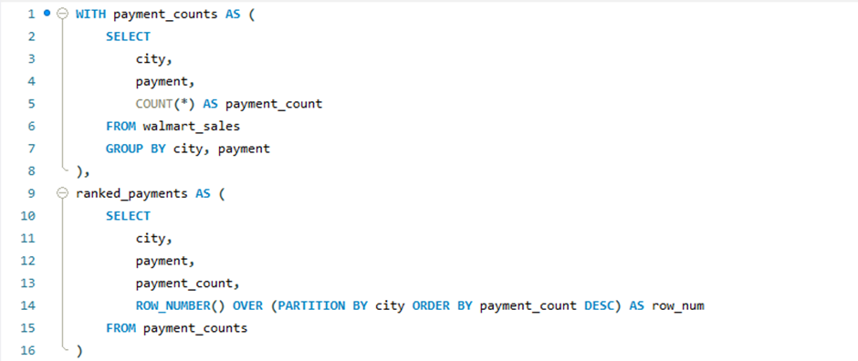
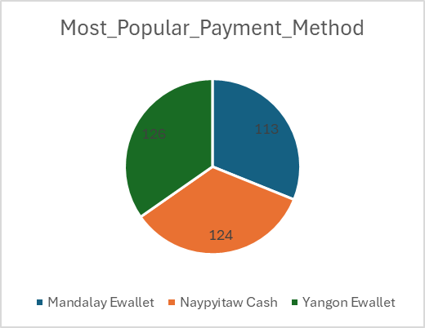
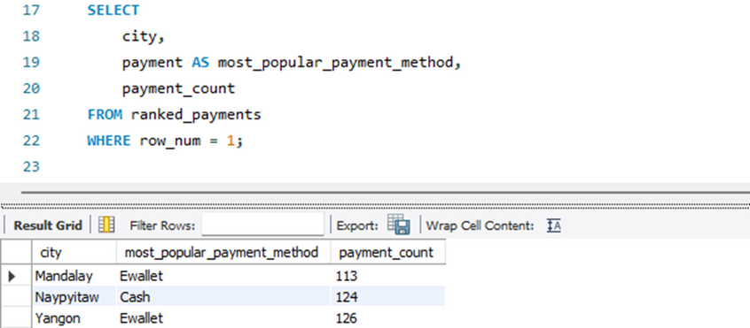
Task 5 : Most Popular Payment Method by City
Walmart needs to determine the most popular payment method in each city to tailor marketing strategies.

Slide 8
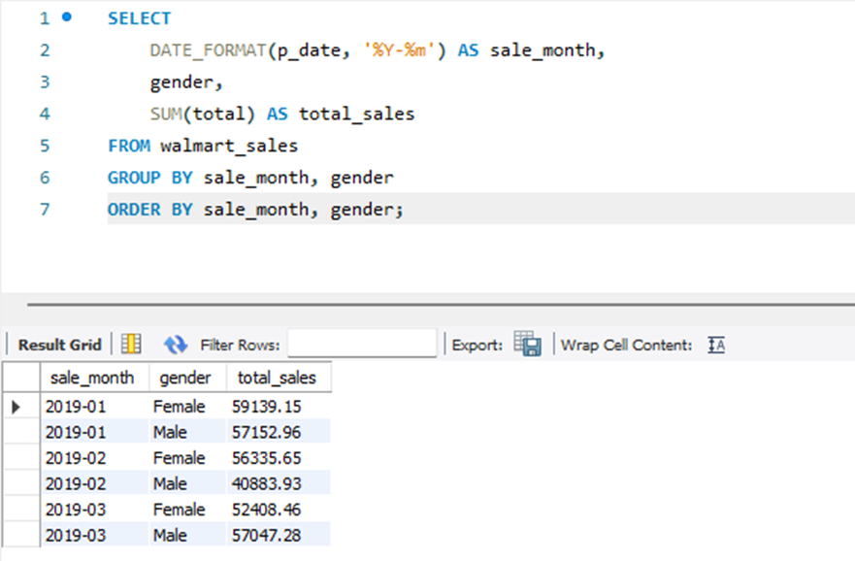
Task 6 : Monthly Sales Distribution by Gender
Walmart wants to understand the sales distribution between male and female customers on a monthly basis.

Slide 9
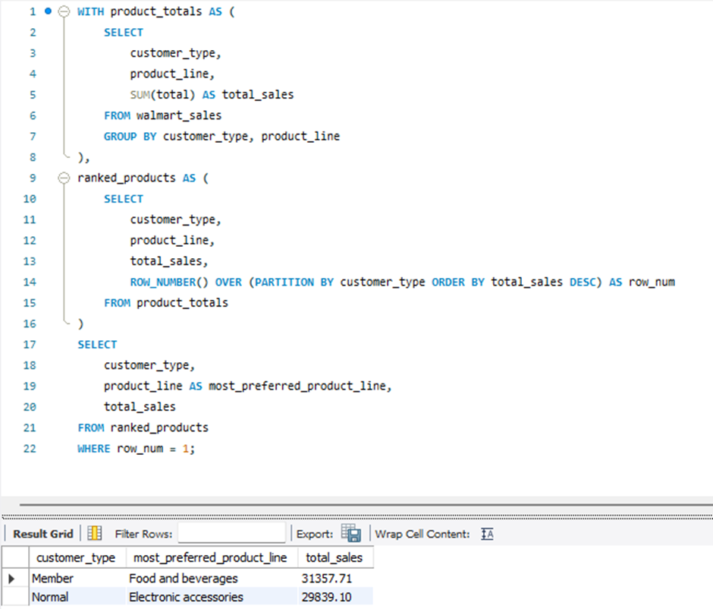
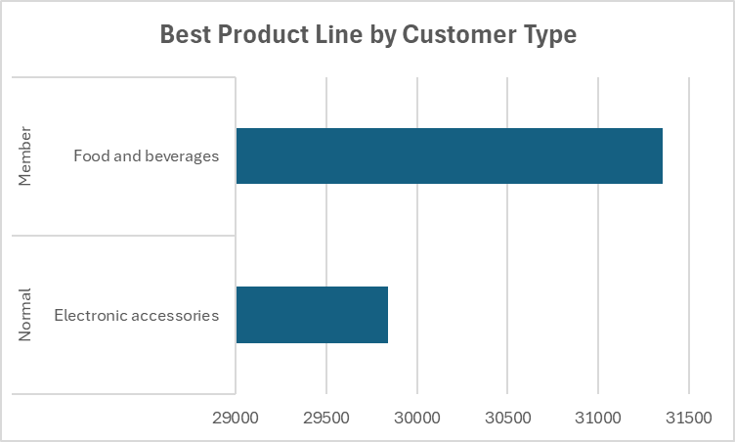
Task 7 : Best Product Line by Customer Type
Walmart wants to know which product lines are preferred by different customer types(Member vs. Normal).

Slide 10
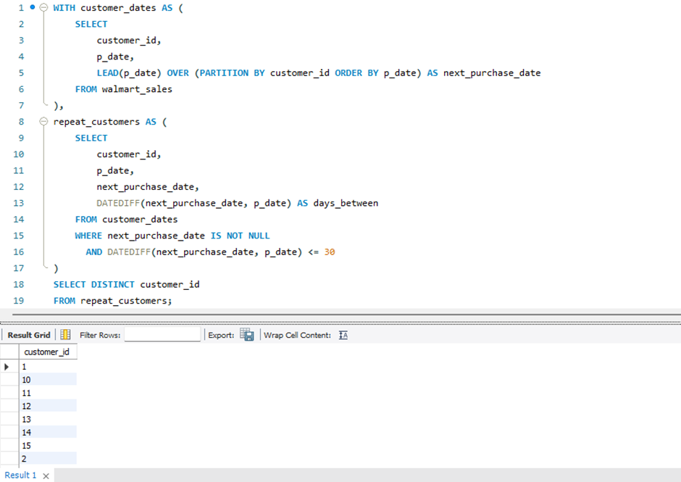
Task 8 : Identifying Repeat Customers
Walmart needs to identify customers who made repeat purchases within a specific time frame (within 30 days).

Slide 11
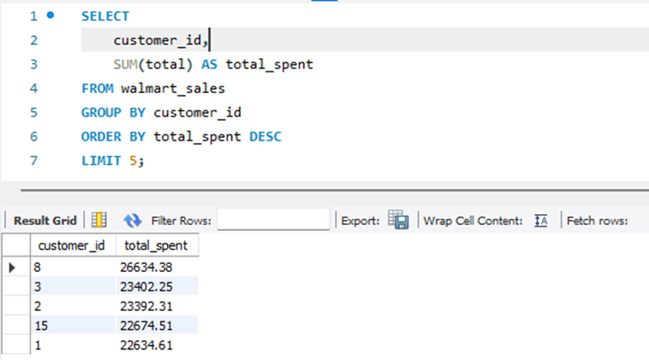
Task 9 : Finding Top 5 Customers by Sales Volume
Walmart wants to reward its top 5 customers who have generated the most sales Revenue.

Slide 12
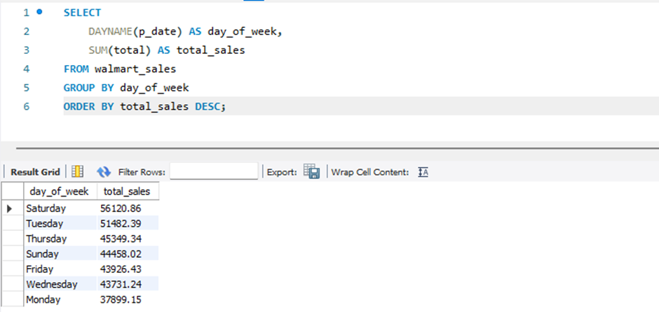
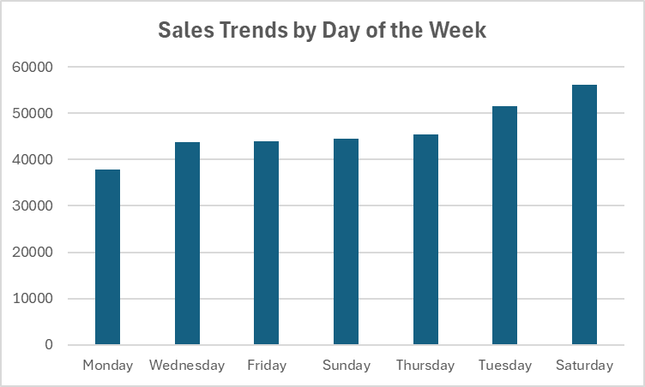
Task 10 : Analyzing Sales Trends by Day of the Week
Walmart wants to analyse the sales patterns to determine which day of the week
brings the highest sales.

Slide 13
Conclusion & Acknowledgment
This project provided a comprehensive analysis of Walmart’s transactional data using advanced SQL techniques.
We explored key business questions related to sales growth, customer behaviour, profitability, and operational insights.
Through structured SQL queries, we identified top-performing branches, customer segments, product trends, and transaction anomalies.
These insights can support data-driven decisions for inventory planning, customer engagement, and revenue optimization.
Video Explanation Link : https://drive.google.com/file/d/1w1U_U88NA6ZZ0fnugd-LYLIAX7jFxmBL/view?usp=sharing

